Slide 1
Person-Centered Planning Process

Slide 2
STAR was developed by
Mickie Hayes, M.Ed.
Director, Florida Consortium on Postsecondary Education and Intellectual Disabilities
and
Mike Muldoon, M.Ed.
Regional Facilitator, Florida Inclusion Network
West Region
Editing: Barbara Smith
Graphic design: Loretta Popp
Cartoon illustrations by Loretta Popp courtesy of FIN

Slide 3
What is Person-Centered Planning?
“Person-centered planning (PCP) is a planning process that focuses on realizing the visions of individuals with disabilities and their families through collaborative partnerships among the individual, family members, friends, professionals, and community members.“
Beach Center on Disabilities
Retrieved February 2, 2014 at http://www.beachcenter.org/families/person-centered_planning.aspx?JScript=1&JScript=1
Notes:
Some examples of person-centered planning include:
-PATH
-MAPS
-STAR and STAR Exit Plan
PATH-Planning Alternative Tomorrows with Hope
MAPS-

Slide 4
The STAR Person-Centered Planning (PCP) Process was designed to ensure students with disabilities who are transitioning into postsecondary programs have the opportunity to plan their own future with the support and encouragement of other adults in their lives.
The STAR PCP process allows students to develop a vision for the future: where they want to live, the work they want to do, and the relationships they want to build.

Slide 5
The STAR PCP process focuses on the student and includes input from others (family, friends, educators, etc.) who can contribute to the student’s life plan.
The STAR PCP process makes it possible to combine the student’s course of study, person-centered planning goals, and IEP goals into one coherent student plan.

Slide 6
Presentation Objectives
Share the vision for the STAR PCP process
Identify the goals of the process
Clarify the roles of participants
Describe the steps in the process
Review the documents used throughout the process

Slide 7
The development of the STAR PCP process was funded by the University of South Florida St. Petersburg through a grant from the Office of Postsecondary Education, United States Department of Education (2010-2015, CFDA 84.407A, P407A100034).

Slide 8
The University of South Florida St. Petersburg partnered with The University of North Florida and Lynn University to form The Florida Consortium on Postsecondary Education and Intellectual Disabilities.
This Florida initiative is an outgrowth of the recommendations from the Governor’s Commission on Disabilities, Education Sub-committee, and with support from the Florida Department of Education, Bureau of Exceptional Education and Student Services.

Slide 9
The Florida Consortium was notified on October 1, 2010 that it was one of 27 recipients of the U. S. Department of Education, Office of Postsecondary Education, Transition Programs for Students with Intellectual Disabilities into Higher Education (TPSID) grants.
The Florida Consortium partnered with the Florida Inclusion Network to develop the STAR PCP process.

Slide 10
Special thanks to the Florida Inclusion Network
Sheryl Sandvoss, Executive Director
Vicki Barnitt, Director of Resource Development
Karen D'Avignon, Regional Facilitator, North Region
Stan Weser, Regional Facilitator, West Region
MJ Ziemba, Regional Facilitator, North Region

Slide 11
We would also like to thank Alisa Lowrey and her colleagues at the Louisiana State University Human Development Center and the Postsecondary Education for All Collaborative (PEAC) for sharing their PCP expertise with us.

Slide 12
Goals of the STAR PCP Process
To recognize and support the individual’s personal plans, hopes, and dreams for life as an adult
To support the student’s pursuit of the necessary skills for a productive adult life
To give the student, family, and friends a voice in supporting the student

Slide 13
Goals of the STAR PCP Process
To develop goals, objectives and an action plan for the student’s postsecondary program
To provide a process for changing goals and plans throughout the student’s postsecondary experience
To encourage the individual to develop lifelong goals and skills leading to an inclusive, well-planned, and fulfilled quality of life

Slide 14
Self-Determination
Self-Determination involves taking control and making decisions that affect one’s life.
Self-Determination helps build independence by allowing students to
Make choices
Set personal goals
Manage their own lives
Participate in decision-making
Notes:
Student involvement also encourages more active parental involvement and interest

Slide 15
Domain Clusters for the STAR PCP
The STAR PCP Process focuses on the following domains:
Career Development and Employment
Academic Enrichment
Campus & Community Engagement
Independent Living
Self-Determination

Slide 16
The STAR PCP process is designed to merge the postsecondary program’s Course of Study, Person-Centered Planning goals, and IEP goals into one coherent student plan.
The process was developed using the course of study from USFSP’s Project STINGRAY, but the five domains are typical of most postsecondary programs for students with intellectual disabilities.

Slide 17
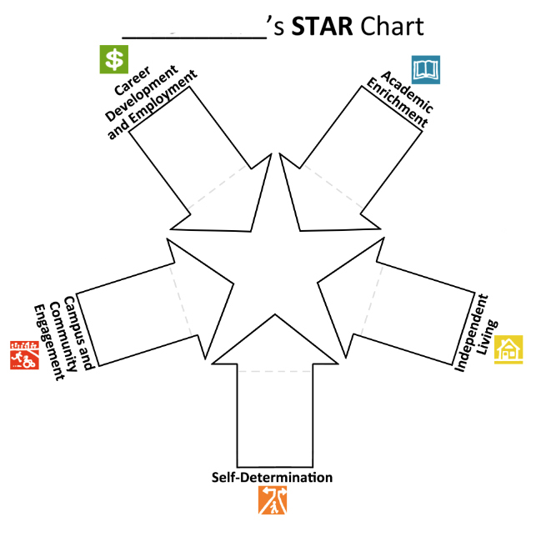
USFSP’s Project STINGRAY Course of Study
Career Development
and Employment
Academic
Enrichment
Campus and
Community
Engagement
Self-Determination
Independent Living

Slide 18
Postsecondary program’s Course of Study
STAR
STAR
IEP Goals
Person-Centered Planning

Slide 19
STAR PCP Team Members
The specific make-up of the STAR PCP Team will vary for each student but will include the following individuals:
Student
Individual with a disability transitioning to a postsecondary college, university or other educational program

Slide 20
STAR PCP Team Members
Campus Coordinator
Chief point of contact for the program
Monitors student progress
Oversees the STAR PCP process
Knowledgeable about the STAR PCP process but must participate in professional development about the STAR PCP process if serving as facilitator or recorder.

Slide 21
STAR PCP Team Members
Facilitator
Organizes the STAR PCP/STAR Exit PCP process
Conducts pre-meeting interviews and the STAR PCP meeting
Ensures the student’s voice is central to the STAP PCP meeting
Sets a respectful tone, poses questions, and clarifies responses
Ensures that the discussion covers all five domains featured on the STAR Chart
Must participate in professional development for the STAR PCP process

Slide 22
STAR PCP Team Members
Recorder
Collaborates with the facilitator throughout the STAR PCP/STAR Exit PCP process
Assists with pre-meeting interviews
Records everyone’s comments on the STAR Chart during the meeting
Must participate in professional development about the STAR PCP process

Slide 23
STAR PCP Team Members
Guest participants
Identified by the student to take part in person-centered planning meeting
May include parents, siblings, other relatives educators, friends, significant other, employers, co-workers, agency staff, clergy, etc.
Should all have an interest in the student’s future
The more participants involved, the richer the information

Slide 24
Prior to STAR PCP Meeting
Identify the facilitator and recorder
Explain the STAR PCP process to the student
Discuss and complete the FERPA forms needed for release of information
Help the student to identify potential guests, send invitations, and plan light refreshments
Contact the Division of Vocational Rehabilitation

Slide 25
Prior to STAR PCP Meeting
Schedule pre-meeting interviews with student and parents/guardians separately before the STAR PCP meeting. Each interview should take between thirty minutes to one hour.
Schedule the STAR PCP meeting
Student pre-meeting interview
Parent/Guardian pre-meeting interview

Slide 26
Prior to STAR PCP Meeting
Record the student’s and parents/guardians’ responses. Interviewers may opt to record responses on side-by-side form or on the individual questionnaires.

Slide 27
Prior to STAR PCP Meeting
The Facilitator and Recorder should meet prior to the STAR PCP meeting to discuss the student and parent/guardian pre-meeting interviews and identify any additional issues or questions that need to be part of the discussion at the meeting.

Slide 28
Prior to STAR PCP Meeting
Reserve a comfortable accessible room
Work with the student to compile RSVPs and remind participants of the date and location of the STAR PCP meeting
Have the STAR Chart enlarged
Gather colored markers, tape or push pins to hang the chart, and other necessary materials

Slide 29
STAR PCP Meeting
On the day of the meeting, the facilitator, recorder, and student will need to do the following tasks:
Set up the room
Set out refreshments
Hang the STAR Chart
Greet participants

Slide 30
STAR PCP Meeting
After everyone arrives
The student introduces the invited guests and other participants
The facilitator provides an overview of the STAR PCP process and explains the STAR Chart
The facilitator sets the ground rules for the meeting

Slide 31
STAR PCP Meeting
Susan

Slide 32
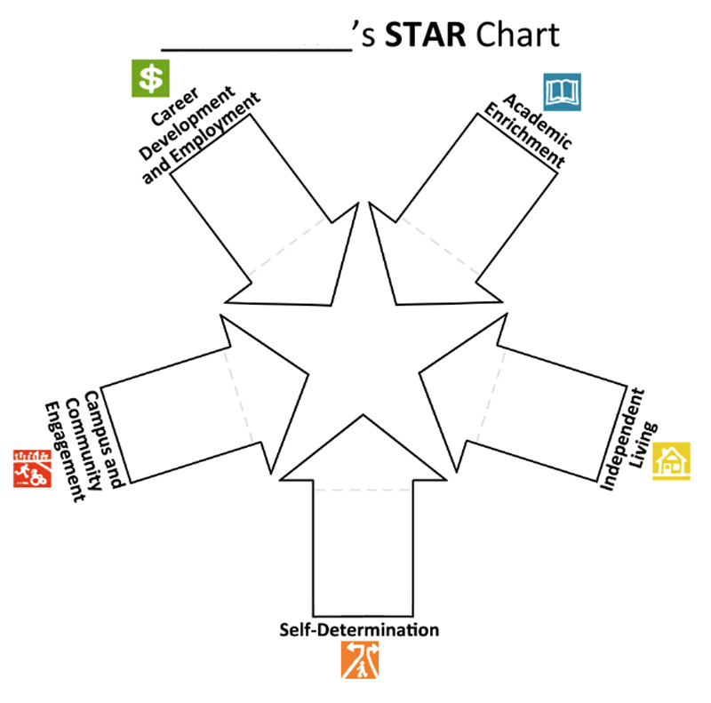
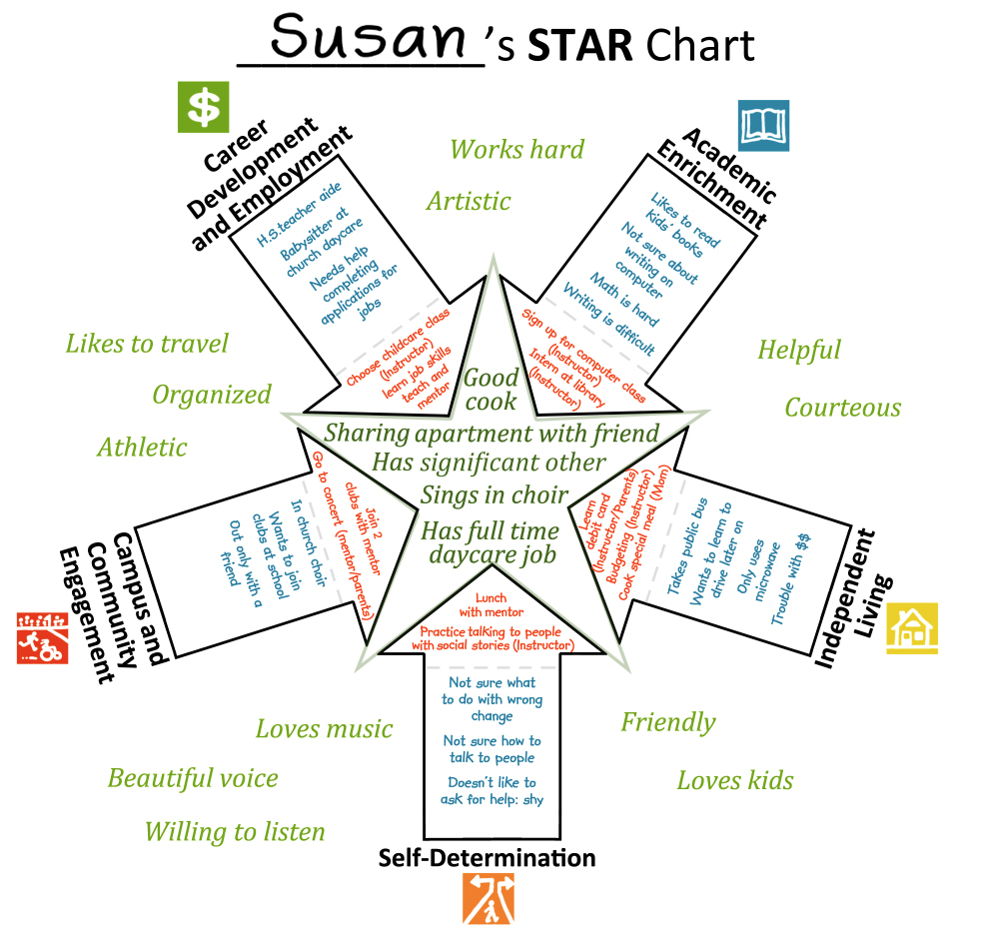
STAR Person-Centered Planning

Slide 33
STAR Meeting Agenda
Activity | Materials/ Actions Needed | Time
Welcome and introductions | N/A | 5 minutes
Explain STAR PCP process and establish ground rules | STAR Chart, chart paper and markers to write down ground rules | 5-10 minutes
Group identifies the student’s unique gifts and talents | Recorder enters responses on STAR Chart | 5-10 minutes
Group describes what the student’s future will look like | Recorder enters responses on STAR Chart | 10-15 minutes
Group provides input about student’s current and future needs | List of guiding questions, pre-meeting interview notes, recorder enters responses on STAR Chart | 45-55 minutes
Group identifies potential “action steps” and people responsible | Recorder enters responses on STAR Chart | 15-25 minutes
Wrap up and adjourn | STAR Chart, camera All interested parties should take a picture of the completed STAR Chart | 5-10 minutes
Notes:
This is an overview of the STAR PCP Meeting agenda and recommended materials and time frame for each activity. This is provided as a guideline – you may need more or less time depending on the size of the group or the complexity of the issues discussed.
Begin the STAR PCP Meeting with a welcome and introductions. It is recommended that, whenever possible, the student should take the lead with this activity.
Next the facilitator provides an introduction to the STAR PCP process. It is imperative to stress that the purpose of the STAR PCP Meeting is provide the student with a forum to explore and express their interests. While the input of the invited guests is critical, ultimately this is about the student’s vision of his/her own future.
The facilitator will also lead the group through a process of establishing ground rules for how the group will work together. A list of sample ground rules is included in the Facilitator’s Guide.

Slide 34
STAR PCP Full Meeting Agenda
Introductions and overview of the STAR PCP process.
Establish the ground rules for the STAR PCP meeting.
Members of the team brainstorm a list of the student’s strengths, gifts, and talents. These are written in the blank space on the outside edge of the STAR Chart.
Everyone, including the student, contributes thoughts and ideas about the student’s future. These suggestions are written into the center star.
If needed, the facilitator can use the Guiding Questions to stimulate the conversation.
In order to determine what needs to occur so that the student can reach his or her future goals, the team must take stock of where the student is today. The recorder will capture this information in the appropriate arrows.
Go back and discuss the student’s STAR qualities, where they are now, and their future goals. This information will help the team to identify possible goals for the STAR Action Plan.
Discuss what the student will focus on over the next year. These goals and objectives will be used to build the STAR Action Plan.
The goals and objectives as well as the people responsible for monitoring them are written in the arrow tips.
All interested parties should take a picture of the completed STAR Chart.
Adjourn

Slide 35
STAR PCP Meeting Agenda
Introductions and overview of the STAR PCP process.
Establish the ground rules for the STAR PCP meeting.

Slide 36
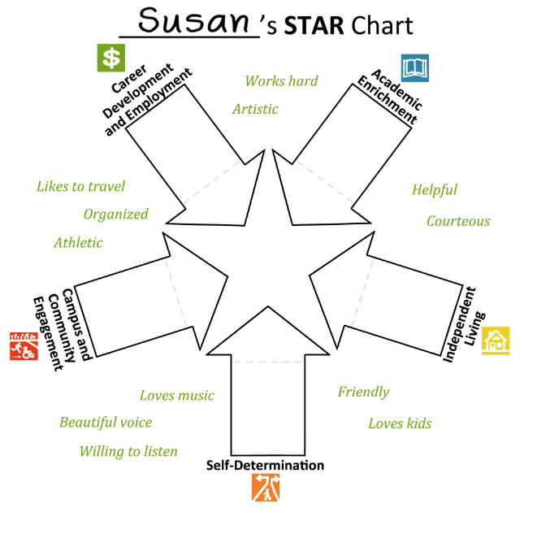
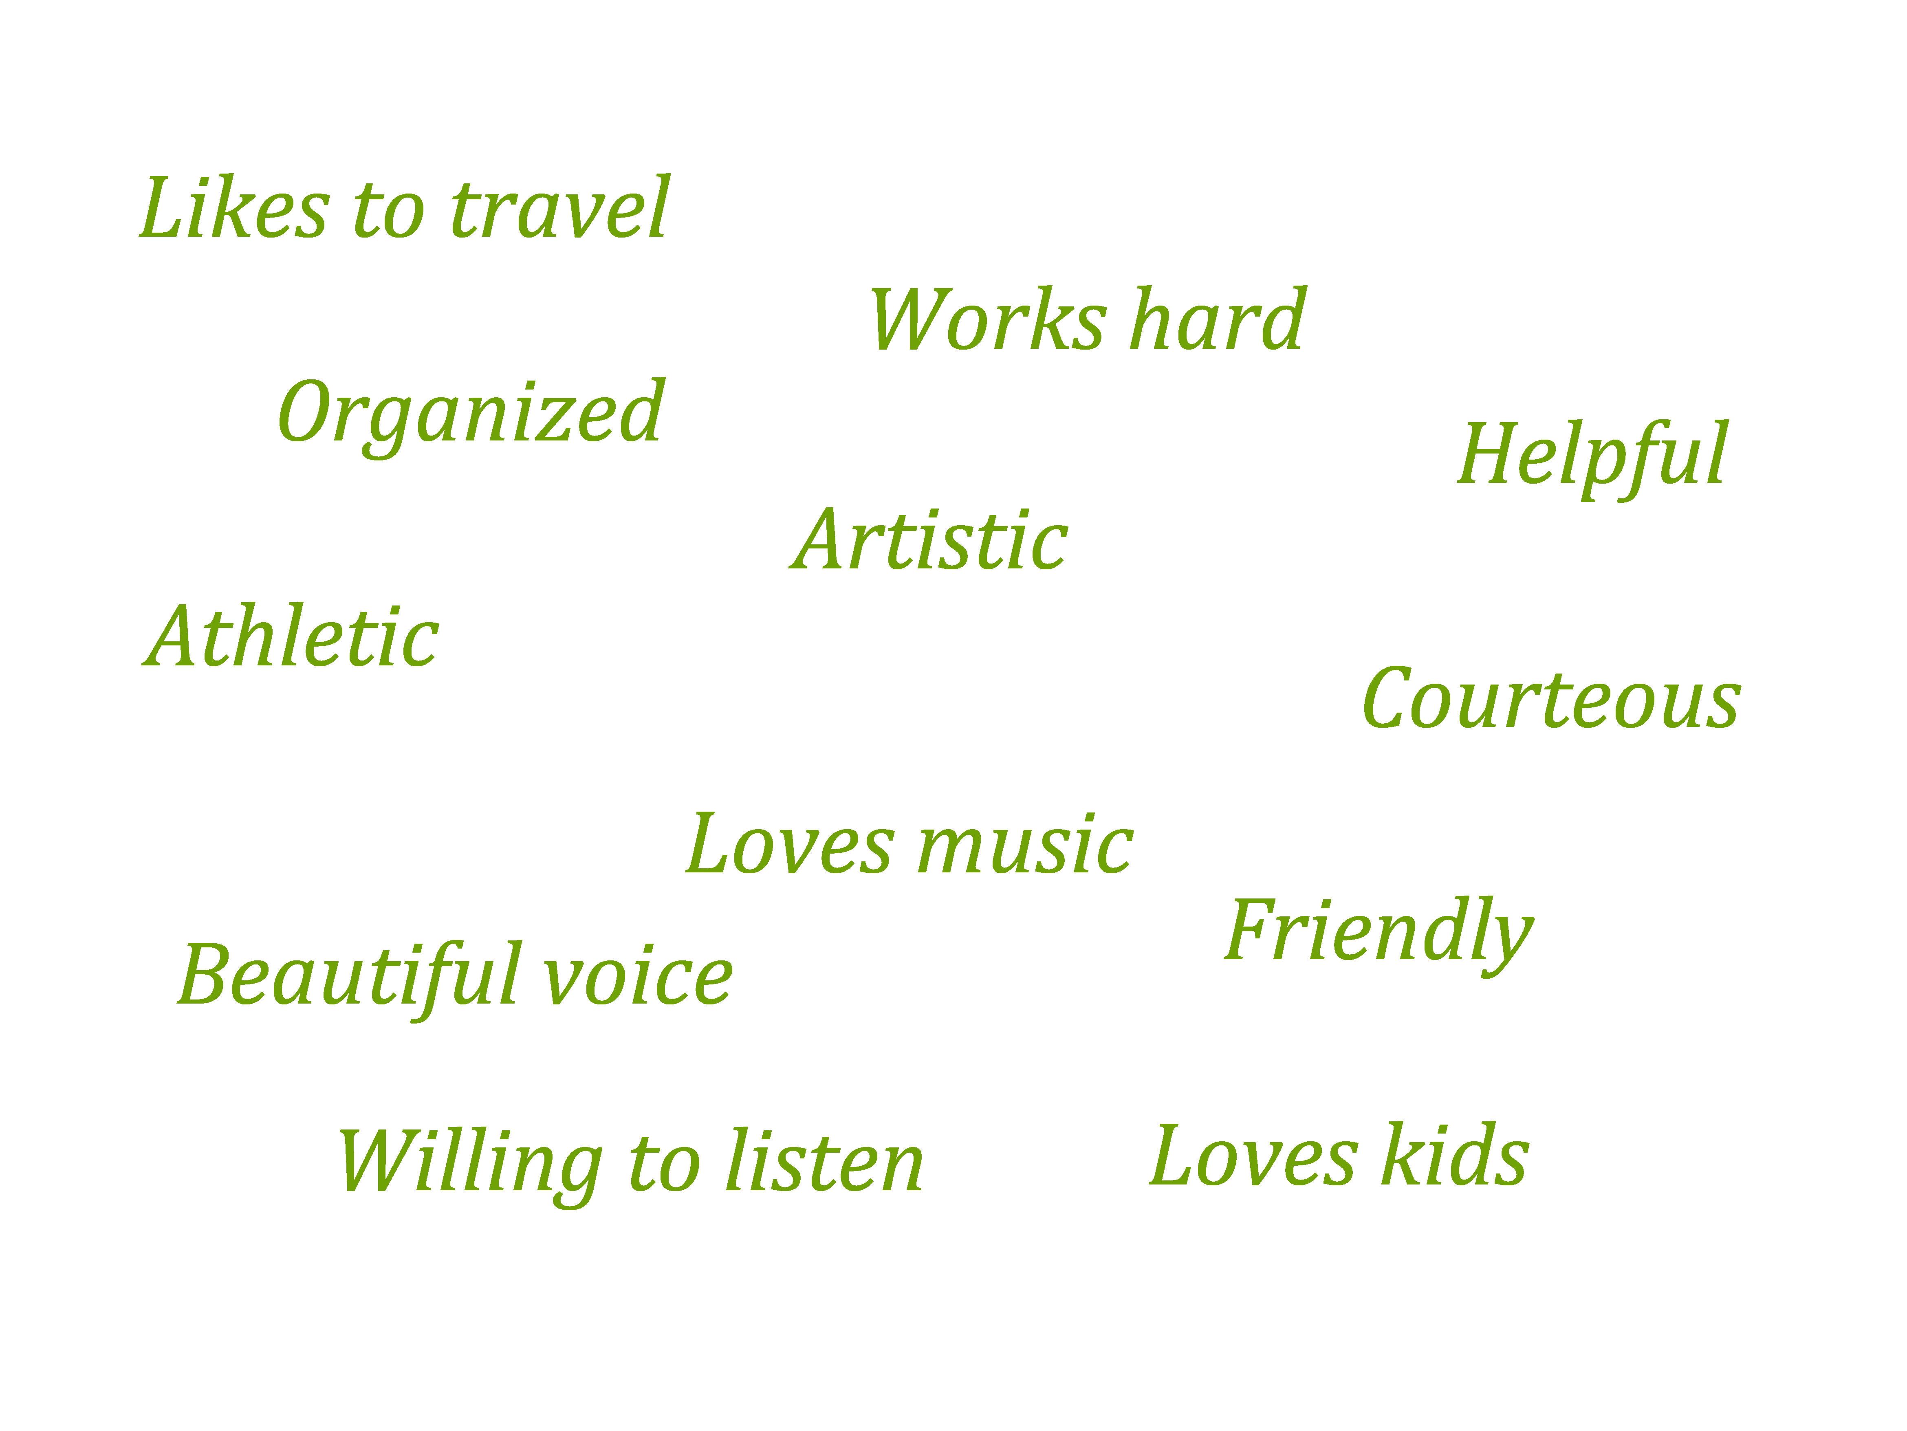
STAR PCP Meeting Agenda
Members of the team brainstorm a list of the student’s strengths, gifts, and talents. These are written in the blank space on the outside edge of the STAR Chart.

Slide 37
STAR PCP Meeting Agenda
Everyone, including the student, contributes thoughts and ideas about the student’s future. These suggestions are written into the center star.
If needed, the facilitator can use the Guiding Questions to stimulate the conversation.

Slide 38
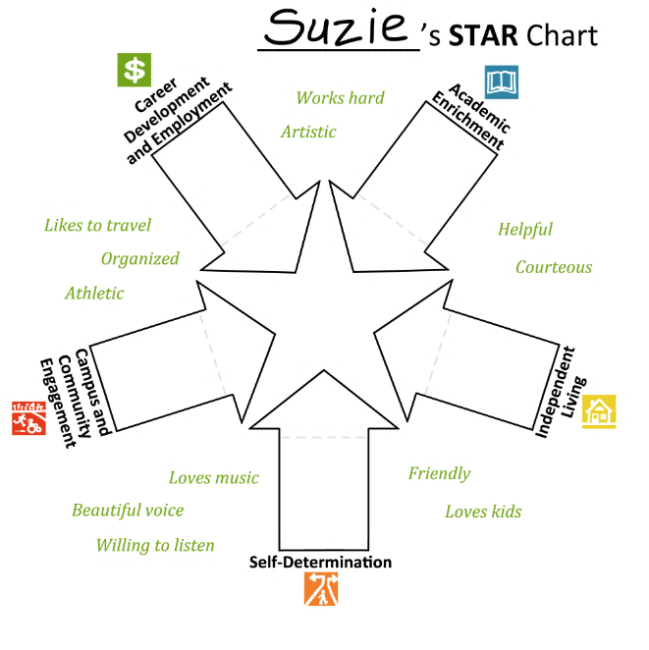
Good
cook
Sharing apartment with friend
Has significant other
Sings in choir
Has full time daycare job

Slide 39
STAR PCP Meeting Agenda
In order to determine what needs to occur so that the student can reach his or her future goals, the team must take stock of where the student is today. The recorder will capture this information in the appropriate arrows.

Slide 41
STAR PCP Meeting Agenda
Go back and discuss the student’s STAR qualities, where they are now, and their future goals. This information will help the team to identify possible goals for the STAR Action Plan.

Slide 42
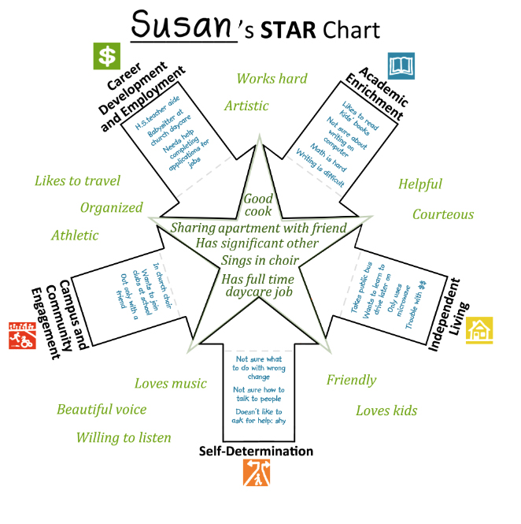

Slide 43
STAR PCP Meeting Agenda
Discuss what the student will focus on over the next year. These goals and objectives will be used to build the STAR Action Plan.
The goals and objectives as well as the people responsible for monitoring them are written in the arrow tips.

Slide 44
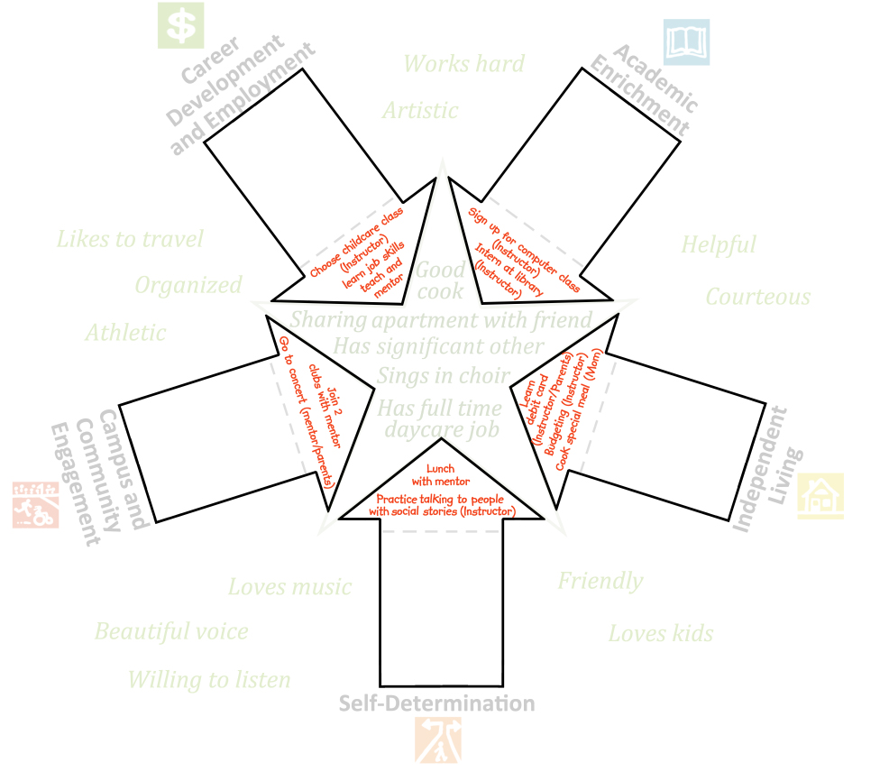

Slide 45
Complete!

Slide 46
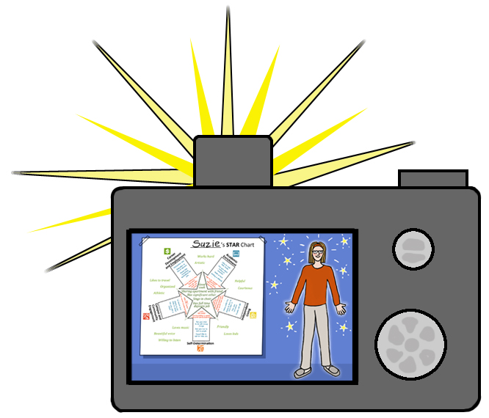
STAR PCP Meeting Agenda
All interested parties should take a picture of the completed STAR Chart.
Adjourn

Slide 47
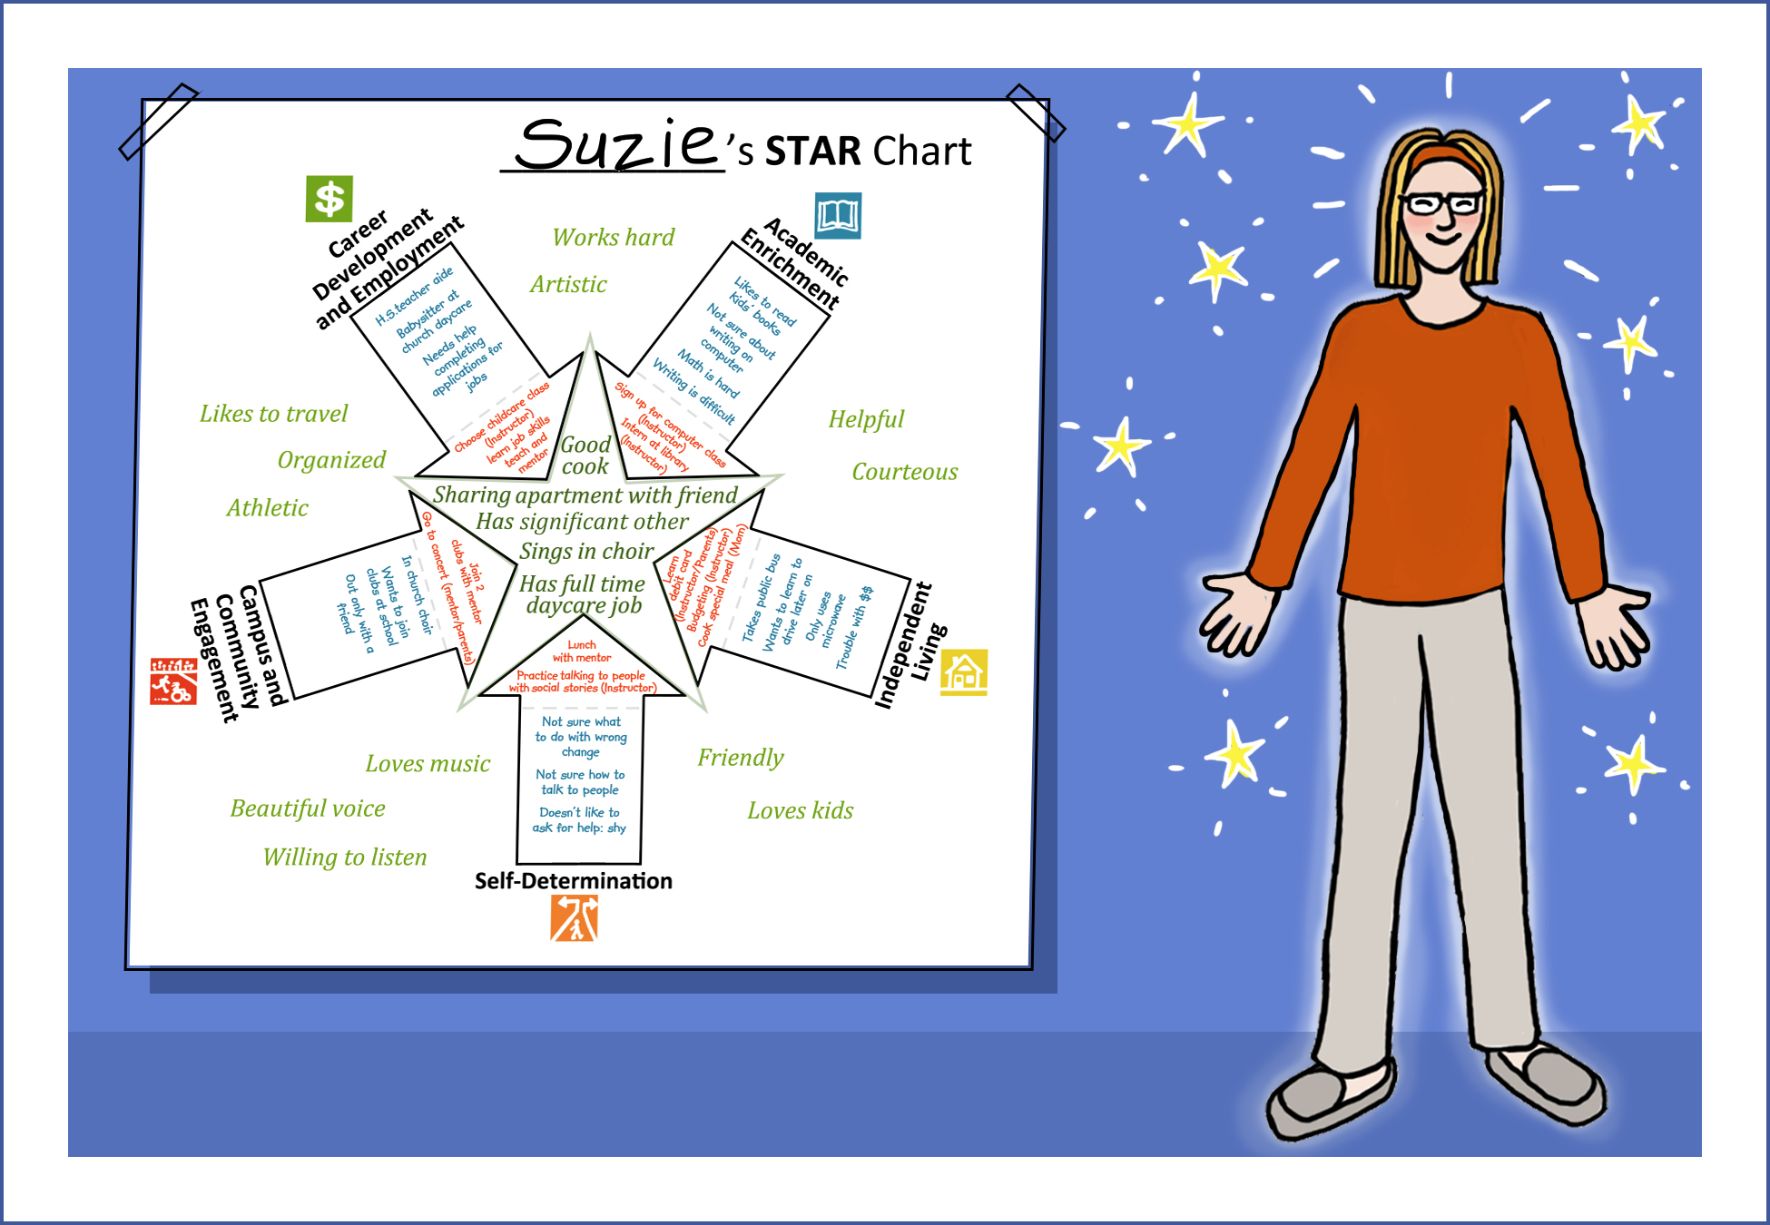

Slide 48
Follow up meeting: STAR Action Plan
Campus coordinator and student meet to complete the action plan.

Slide 49
STAR Action Plan
Once the STAR Action Plan has been completed, get copies to all of the people who are instrumental in carrying out the student’s goals.

Slide 50
STAR Action Plan
Discuss the goals and objectives from the STAR Action Plan as needed throughout the year, and schedule a new STAR PCP if the student’s future plans change.

Slide 51
STAR Action Plan
The STAR Action Plan should be reviewed regularly and updated at least annually. The campus coordinator and the student will review each goal and assess the student’s progress based on a five-point scale:
Not currently working on goal
Planning early stages of goal
Demonstrating minimum progress on goal
Making satisfactory progress on goal
Reached goal

Slide 52
STAR Exit PCP
The STAR Exit PCP is an option for students graduating or exiting the program. At the completion of this process, the student will receive a list of community and agency resources tailored to their long-term goals.

Slide 53
________________’s Exit STAR Chart

Slide 54
STAR Exit PCP
Helps student think about the future and plan goals and support needs for:
Employment
Lifelong Learning
Community Engagement
Independent Living
Self-Determination
__________’s STAR Chart

Slide 55
Resource Guide for Exiting Students
The Resource Guide is a separate document that is given to students who are exiting from the program.
A draft of the document can be filled out at the STAR Exit PCP meeting by the teacher.
The teacher, student, and parent(s) can finalize the document at a later date.

Slide 56
If you have any questions or need more information, contact:
Mickie Hayes - mhayes6@mail.usf.edu
Mike Muldoon - mmuldoon@mail.usf.edu
Download STAR PCP materials at: www.fltpsid.info

Slide 57
Use the following citation when referencing STAR :
Hayes, M. and Muldoon, M. (2014). STAR (Students Transitioning to Adult Roles) Person Centered Planning Process. Transition Programs for Students with Intellectual Disabilities into Higher Education (TPSID) grant awarded to the Florida Consortium on Postsecondary Education and Intellectual Disabilities from the U. S. Department of Education, Office of Postsecondary Education from 2010 - 2015. (#CFDA 84.407A, P407A100034).

