Slide 1
Welcome to College!
Our plan
is to help YOU plan
your college future!

Slide 2
STAR stands for
Students Transitioning to Adult Roles
As you enter college,
that’s what you are doing.

Slide 3
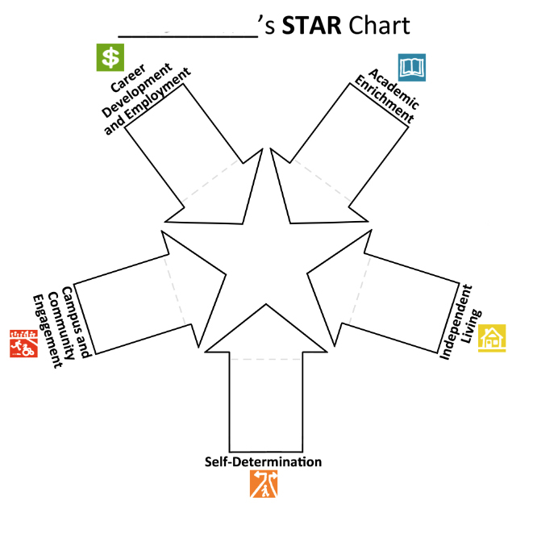
With STAR you are the star of a process
to help you plan for a great future in college and beyond.
This chart
is what we will
be using during the meeting.

Slide 4
First, you will decide who you think can help you with your plan:
Parents, brothers, sisters, aunts,
uncles, grandparents, cousins,
classmates, friends, neighbors,
bosses, teachers, clergy, co-workers, mentors and job coaches.
You’ll invite these people to a special meeting, called STAR Person-Centered Planning.

Slide 5
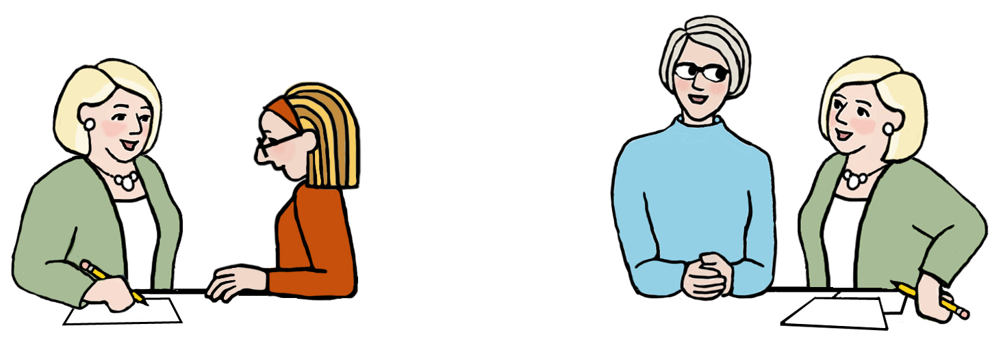
We’ll schedule two interviews before the STAR Person Centered Planning meeting, one with you and one with your parents.
These interviews will help us get to know you before the big group meeting.

Slide 6
T h e n . . .
We’ll set a date for your STAR !
You can send out invitations and plan refreshments for your guests.

Slide 7
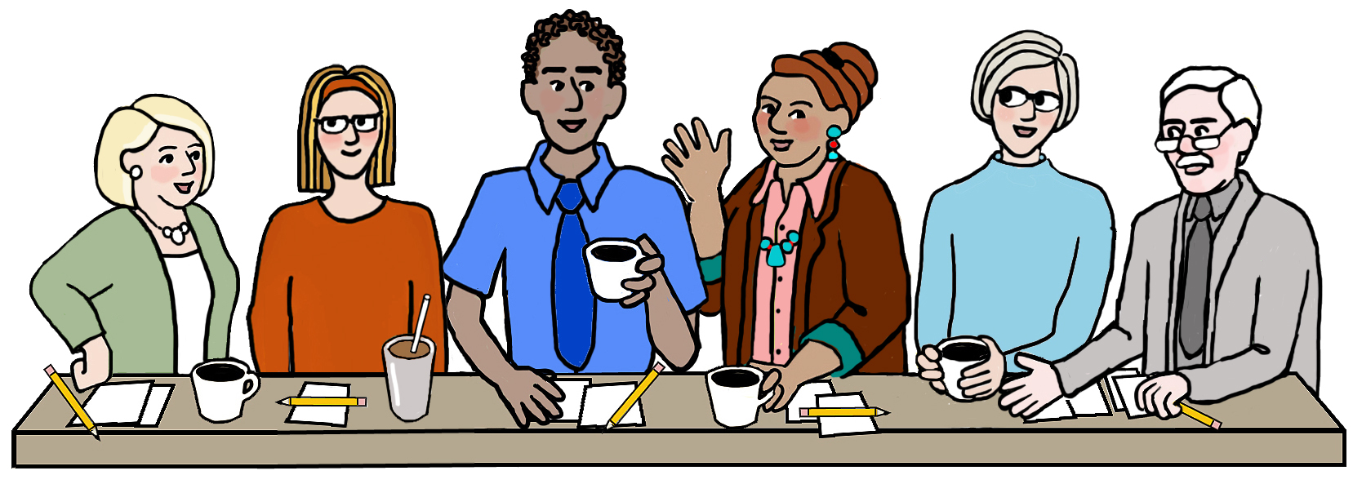
You, your family, and invited guests will all join us at the college for your STAR Person Centered-Planning meeting.
We’ll talk about you, your dreams for the future and how you can plan goals for college to help achieve them.

Slide 8
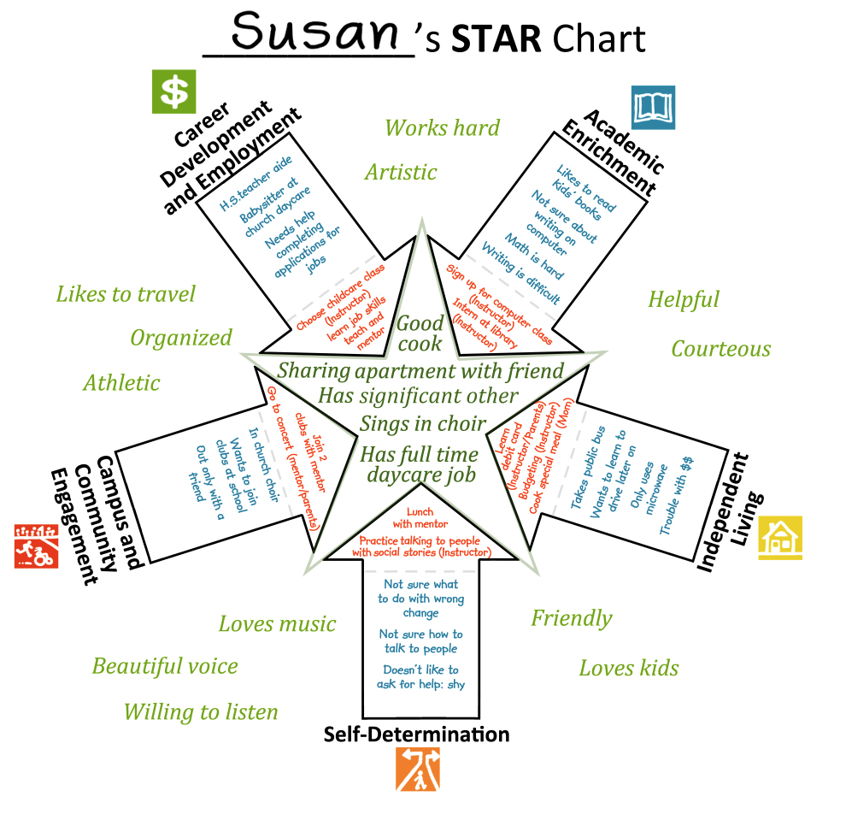
At the end of the meeting, you’ll have a STAR chart filled out with help from the people who care most about your future.

Slide 9
You and your teacher will then work together to prepare your own STAR Action Plan to guide you through those college goals.

Slide 10
With your STAR plan, you’ll be ready to star in your college life.

